Slide 1
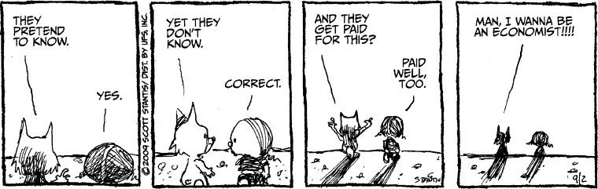
The Economic Way of Thinking and Market Equilibrium
Management 405
Prof. Melanie Wasserman · UCLA Anderson

Slide 2
The Economic Way of Thinking · Course Overview
Course Overview: Introductions
Instructor:
Associate Professor of Economics in the GEM area
BA in Economics, UC Berkeley
PhD in Economics, MIT
Labor economist: study of work and pay
See website for more www.melaniewasserman.com
Contact: melanie.wasserman@anderson.ucla.edu
TAs: Advanced PhD students in Economics & Management
Section 3:
Section 4:
You!
Management 405 · The Economic Way of Thinking
2

Slide 3
The Economic Way of Thinking · Course Overview
Course Overview: How to Succeed in This Class
Readings
Textbook: Goolsbee, Levitt, Syverson (4th edition)
News articles/podcasts (feel free to send me suggestions!)
Slides: uploaded 24 hours in advance; slides with solutions to in-class exercises uploaded after class
Class participation: broadly defined!
Problem sets
Optional practice exercises: textbook/online exercises on BruinLearn
Opportunities outside the classroom
My office hours: by appt, just email me!
TA weekly session/office hours
Group coffee chats: link to Google doc on BruinLearn
Management 405 · The Economic Way of Thinking
3

Slide 4
The Economic Way of Thinking · Course Overview
Course Overview: TA Weekly Sessions
Each session
First half: review of class concepts, practice exercises
Second half: informal Q&A
Vote on timing on next slide
Management 405 · The Economic Way of Thinking
4

Slide 5
The Economic Way of Thinking · Course Overview
Course Overview: Grading
Midterm 25%
Final 40%
Problem sets 25%
Class participation 10%
Grade distribution follows Anderson policy
Management 405 · The Economic Way of Thinking
5

Slide 6

The Economic Way of Thinking · PollEV
Poll: Zoom Weekly TA Session
Management 405 · The Economic Way of Thinking
6
Notes:
Do not modify the notes in this section to avoid tampering with the Poll Everywhere activity.
More info at polleverywhere.com/support
Zoom Weekly TA Session Poll
https://www.polleverywhere.com/multiple_choice_polls/CqfNP2hhdu7Xdjd1PUSi1?display_state=instructions&activity_state=opened&state=opened&flow=Engagement&onscreen=persist

Slide 7

The Economic Way of Thinking · PollEV
Poll
Management 405 · The Economic Way of Thinking
7
Notes:
Do not modify the notes in this section to avoid tampering with the Poll Everywhere activity.
More info at polleverywhere.com/support
Zoom Weekly TA Session Poll
https://www.polleverywhere.com/multiple_choice_polls/CqfNP2hhdu7Xdjd1PUSi1?display_state=chart&activity_state=opened&state=opened&flow=Engagement&onscreen=persist

Slide 8
The Economic Way of Thinking · Course Overview
Course Overview: Structure of Class Sessions
3 hours, once per week
Introduce and develop proficiency in economic tools
Theory
Real life examples, including in-depth discussion of cases
Interactive exercises (group discussions, PollEV exercises)
Encourage class participation
Discussion overflow: BruinLearn discussion forum
Provide pointers to problem sets
Class recordings: available on BL after class session
Management 405 · The Economic Way of Thinking
8

Slide 9

The Economic Way of Thinking · Course Overview
Goals for Management 405
Provide tools based on ”the economic way of thinking” for making better managerial decisions
Understand and predict how and why economic entities (consumers, producers, industries…) behave as they do
Understand/anticipate/contest economic concepts and arguments (including in job interviews)
WHY SHOULD YOU STUDY ECONOMICS?
Management 405 · The Economic Way of Thinking
9
Notes:
And it will make you richer!
Black, Sanders and Taylor « The Economic Reward for Studying Economics », Economic Inquiry 41, no 3 (2003)
http://www.payscale.com/college-salary-report/majors-that-pay-you-back/bachelors

Slide 10

The Economic Way of Thinking · Introduction
Homo Economicus Can Help Us With…
Individual decisions
Buy a product?
Pursue an MBA?
Drive 5 miles to get cheaper gas?
Firm decisions
Hire an additional employee?
Build a new factory?
Shut down?
Government decisions
Implement a minimum wage?
Impose rent control?
Tax sugary drinks?
Management 405 · The Economic Way of Thinking
10

Slide 11
The Economic Way of Thinking · Course Roadmap
Agenda for the Class
we are here
1. The Economic Way of Thinking (Module 1)
2. Value and Demand
3. Supply and Cost
4. Markets, Pricing and Strategy
Management 405 · The Economic Way of Thinking
11

Slide 12
The Economic Way of Thinking · Outline
Outline
1
Value of the Firm
What a firm maximizes — and why value is not the same as current profit
2
Basic Principles of Economic Thinking
Opportunity costs · Sunk costs · Cost-benefit and marginal analysis
3
Economics Fundamentals
Markets · Supply and Demand · Equilibrium
Management 405 · The Economic Way of Thinking
12

Slide 13
The Economic Way of Thinking · Outline
Outline
1
Value of the Firm
What a firm maximizes — and why value is not the same as current profit
2
Basic Principles of Economic Thinking
Opportunity costs · Sunk costs · Cost-benefit and marginal analysis
3
Economics Fundamentals
Markets · Supply and Demand · Equilibrium
Management 405 · The Economic Way of Thinking
13

Slide 14
The Economic Way of Thinking · Value of the Firm
What Makes a Firm Successful?
What makes a firm successful?
How do you measure the value of a firm?
Class discussion
Management 405 · The Economic Way of Thinking
14

Slide 15
The Economic Way of Thinking · Value of the Firm
Firm's Objective: Maximizing Long Term Profits = Value
R₁ − C₁
+
R₂ − C₂
+
R₃ − C₃
+ ⋯ +
Rₜ − Cₜ
V = R₀ − C₀ +
1 + r
(1 + r)²
(1 + r)³
(1 + r)ᵗ
R = Revenue; C = Cost; r = discount rate
The criterion for judging decisions is the impact on a firm's value, not the impact on its current profitability
Value (V) is the present discounted value of future profits
Management 405 · The Economic Way of Thinking
15
Notes:
Value is all the profits: The true measure of success is value. Value means the present discounted value (PDV) of future profits. Tesla might have a huge loss now, but investors are still excited since they expect huge returns in the future.
Technological superiority, market share, growth, revenues and markups are only components of the PDV.
Where does 1+r come from? A dollar today is better than a dollar tomorrow. What value of the discount rate (r) should be used? This is a subject you will cover in finance, but think of the market rate of interest for now. Why? Alternative use of resources would produce this revenue if placed on an account yielding the market rate.
Factoid: Alexander Trotman (later 'Lord Trotman of Osmotherley in the County of North Yorkshire’), the CEO of Ford Motor Co from 1993 to 1998, once announced that his goal was for Ford to have a market share greater than GMs. Stock price fell on impact. Why? Market share is not profits, but stock price tracks value of the firm pretty closely.

Slide 16

The Economic Way of Thinking · Discussion
Discussion: WSJ Barro's Article
Maximizing long term profits: is this the right/ethical goal?
Would Bill Gates create more social value by running Microsoft or by giving away his money through the Gates Foundation?
Class discussion
Management 405 · The Economic Way of Thinking
16
Notes:
Question for debate: Did Bill Gates create more social value by running Microsoft and supplying Windows to the market or by giving away his billions fighting AIDS in Africa? Probably the former. From Robert Barro:
“Here is a sketch of a simple model of Microsoft's social value. The market value of the company's stock recently hit $287 billion. In 2006, its revenue was $44 billion, with earnings of $13 billion. This money was generated by creating something consumers value. Only Microsoft's competitors could believe that this much market value, revenue and earnings would have been created by delivering products that have little value to society.
Suppose that a copy of a new version of Windows sells for $50 (and is typically charged as part of the price of a personal computer). Microsoft's revenue from Windows would then equal $50 multiplied by the number of copies consumers snap up. Microsoft's earnings are the revenue less production and development expenses. But that's not the social value. That comes from the increase in productivity created when businesses and households use the software. The social benefit equals the value of the extra product, less the total paid for the software. Almost by definition, the benefit has to be positive. Otherwise, why would consumers willingly pay for Windows?
A conservative estimate, in a model where software serves as a new variety of productive input, is that the social benefit of Microsoft's software is at least the $44 billion Microsoft pulls in each year. When capitalized with the same ratio (22) that the market applies to earnings, this flow corresponds to a valuation of $970 billion. Thus, through Microsoft's future operations, Mr. Gates is creating a benefit to the rest of society of about one trillion dollars -- or more than 10 times his planned donations. And this counts only the likely future benefits, giving no weight to the past.” WSJ June 19, 2007.
However, one might also take into account that we as a society might value more money given to the poor (in terms of charity) compared to money given to the well-off (in terms of happiness from using Windows net of the price of license). To complicate the discussion even more, Windows might also help people doing the humanitarian projects, which adds to the value of Bill Gates as an entrepreneur.
We might also want to figure out what is the cost-efficiency of charitable giving: how much value does Bill Gates generate for each additional dollar he gives to charity. To do so, we can look at estimates by GiveWell.org, an NGO using randomized controlled trials to figure out the best ways of spending charitable money.

Slide 17
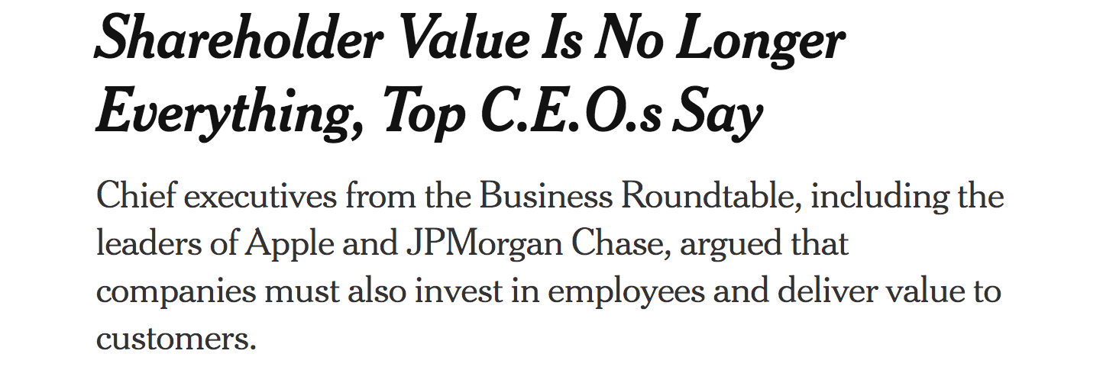
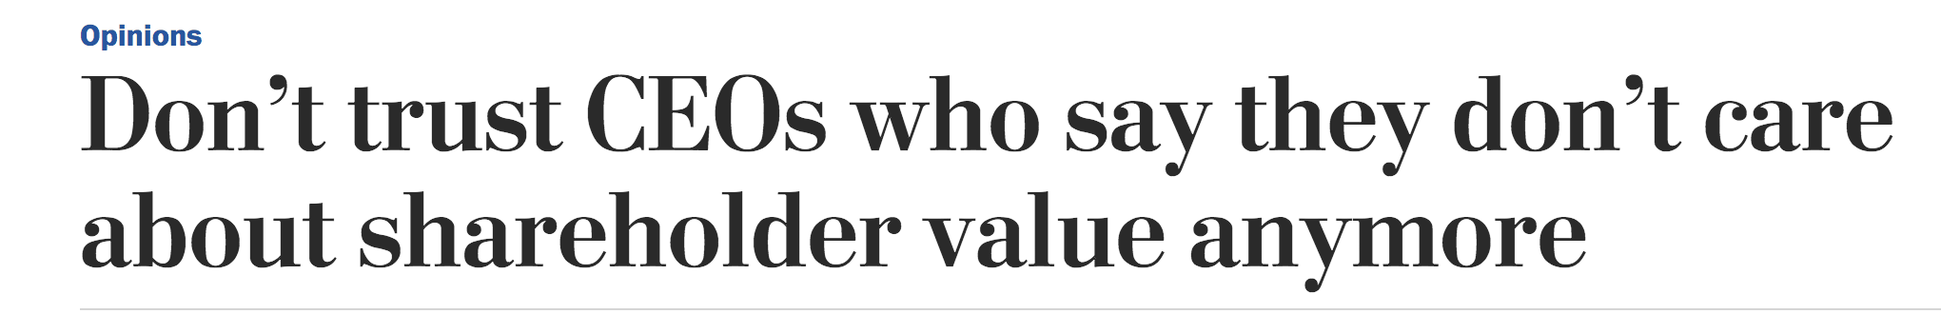
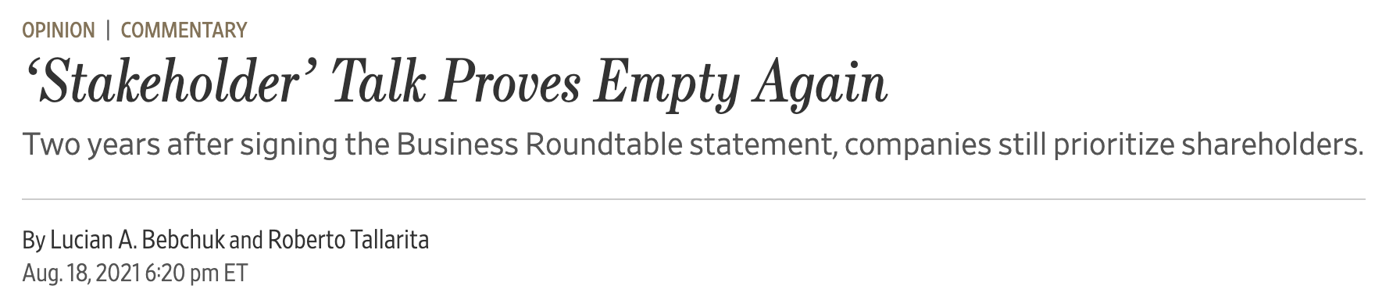

The Economic Way of Thinking · Discussion
Discussion: NYT Roundtable / WSJ New Approach
Class discussion
Management 405 · The Economic Way of Thinking
17
Notes:
See the NYT and WaPo articles:
https://www.nytimes.com/2019/08/19/business/business-roundtable-ceos-corporations.html
https://www.washingtonpost.com/opinions/2019/08/20/dont-trust-ceos-who-say-they-dont-care-about-shareholder-value-anymore/

Slide 18
The Economic Way of Thinking · Outline
Outline
1
Value of the Firm
What a firm maximizes — and why value is not the same as current profit
2
Basic Principles of Economic Thinking
Opportunity costs · Sunk costs · Cost-benefit and marginal analysis
3
Economics Fundamentals
Markets · Supply and Demand · Equilibrium
Management 405 · The Economic Way of Thinking
18

Slide 19
The Economic Way of Thinking · Outline
Outline
1
Value of the Firm
What a firm maximizes — and why value is not the same as current profit
2
Basic Principles of Economic Thinking
Opportunity costs · Sunk costs · Cost-benefit and marginal analysis
3
Economics Fundamentals
Markets · Supply and Demand · Equilibrium
Management 405 · The Economic Way of Thinking
19

Slide 20
The Economic Way of Thinking · Opportunity Costs
Economic Costs include Opportunity Costs
The opportunity cost is the value of the next best alternative sacrificed
What you give up to get something
The opportunity cost is not always monetary. It is often implicit rather than explicit
Explicit cost: actual payment
Implicit cost: forgo an alternative action
Full economic cost = implicit cost + explicit cost
Management 405 · The Economic Way of Thinking
20
Notes:
The opportunity cost is the value of the next best opportunity foregone.
E.g. 1: spend 1) $20 on a shirt, 2) $20 on a dinner or 3) $20 on a Taylor Swift album. In all three cases you spend $20 so that is not part of the relevant costs. The real cost is you have to forego the next best alternative. i.e. by choosing 1, you forego 2. It had better be that the benefit of choosing 1 exceeds the benefit of choosing 2 (i.e. the benefit of 1 exceeds the opportunity cost of 1). Cost-benefit analysis in a world of tradeoffs requires a consideration of alternatives. Cost is relative to alternatives.
E.g. 2: What is the opportunity cost of using excess factory capacity to supply specialty orders? If the capacity would otherwise go unused, the opportunity cost is zero (or small – the capacity would be committed in the unlikely event that a regular order would arrive unexpectedly).
E.g. 3: As mayor of Santa Monica you have to decide whether to turn a patch of land owned by the city into a parking lot. What is the opportunity cost of doing so? The land could be sold on the open market at its market price. The opportunity cost is the market price of the land, or the value of some alternative municipal value, whichever is greatest (in general the market price reflects well the value of alternatives). In this case the cost is implicit, but if the city did not own the land, it would have to buy it, and the cost would be explicit.

Slide 21
The Economic Way of Thinking · Opportunity Costs
Principle of Opportunity Cost
Alternatives
My Value
My Opp. Cost
Apple
4
3
Banana
3
4
Cucumber
2
4
Dragon fruit
1
4
The opportunity cost is the value of next best alternative foregone
(the lost opportunity)
Opportunity cost depends on preferences – it differs across individuals
Management 405 · The Economic Way of Thinking
21

Slide 22
The Economic Way of Thinking · Opportunity Costs
What is the Opportunity Cost of Doing an MBA?
Do an MBA OR work (more)?
Do an MBA OR travel?
Pay tuition OR invest money?
Class discussion
Management 405 · The Economic Way of Thinking
22

Slide 23
The Economic Way of Thinking · Opportunity Costs
Flip a House or Work?
Flip house:
1 year of full-time work
Buy for 500k
Invest another 100k (+ your full time)
Expected sale price in a year: 700k
Consulting job offer:
Full-time job (not compatible with flipping the house)
Pays 150K
What is the economic profit of flipping the house?
➜ Problem Set 1, #1
PollEV
Management 405 · The Economic Way of Thinking
23

Slide 24
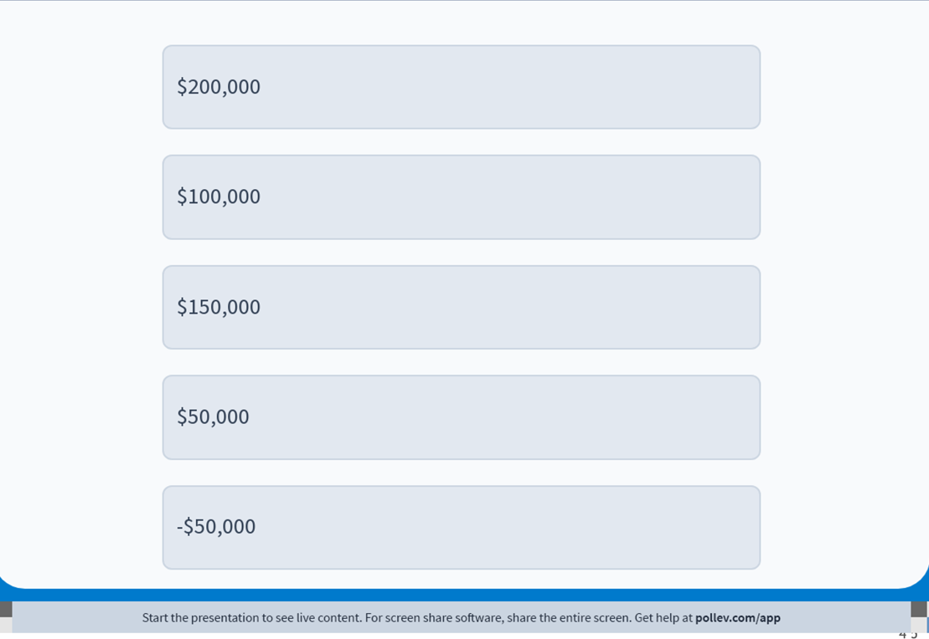
The Economic Way of Thinking · Opportunity Costs
What is the economic profit of flipping the house?
Management 405 · The Economic Way of Thinking
24

Slide 25
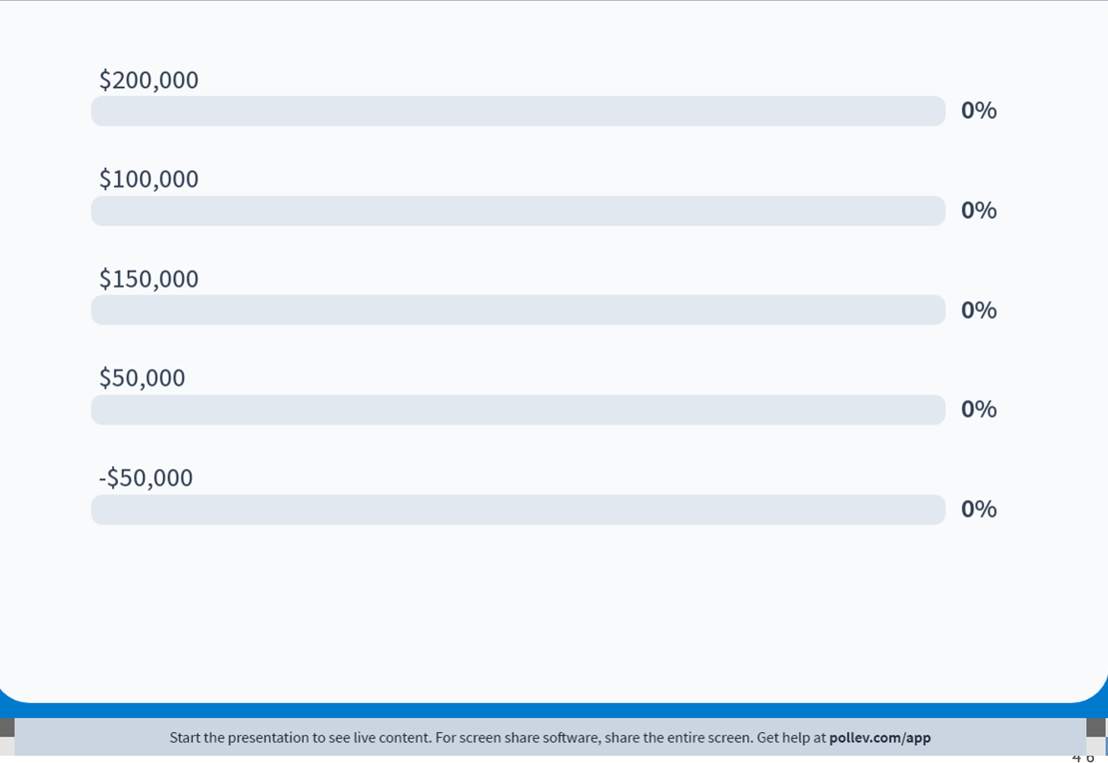
The Economic Way of Thinking · Opportunity Costs
What is the economic profit of flipping the house?
Management 405 · The Economic Way of Thinking
25

Slide 26

The Economic Way of Thinking · Opportunity Costs
Solution
Flip the house:
Economic revenues: 700k
Explicit costs: 600k
500k for the purchase, 100k for remodeling
Implicit (opportunity) costs: 150k
The ‘lost opportunity’ to take the consulting job
Economic profits of flipping the house: -50k (loss)
= 700k − 600k − 150k
Another consideration:
What about the opportunity cost from the 600K of investment (buying house + 100k investment)? That could also add to the implicit costs.
Podcast
Management 405 · The Economic Way of Thinking
26

Slide 27
The Economic Way of Thinking · Opportunity Costs
What is the Entrepreneur's Economic Profit after One Year?
Cindy, a young entrepreneur, is deciding whether to start a company
Projected annual revenues = $300,000
Projected annual explicit costs = $200,000
Personal capital Cindy has to invest in her startup=$50,000 (principal is recovered after 1 year)
Market rate of interest = 6%
Cindy is also offered a job in consulting with a net income of $150,000 per year. She cannot take it if she starts her company
PollEV
Management 405 · The Economic Way of Thinking
23

Slide 28
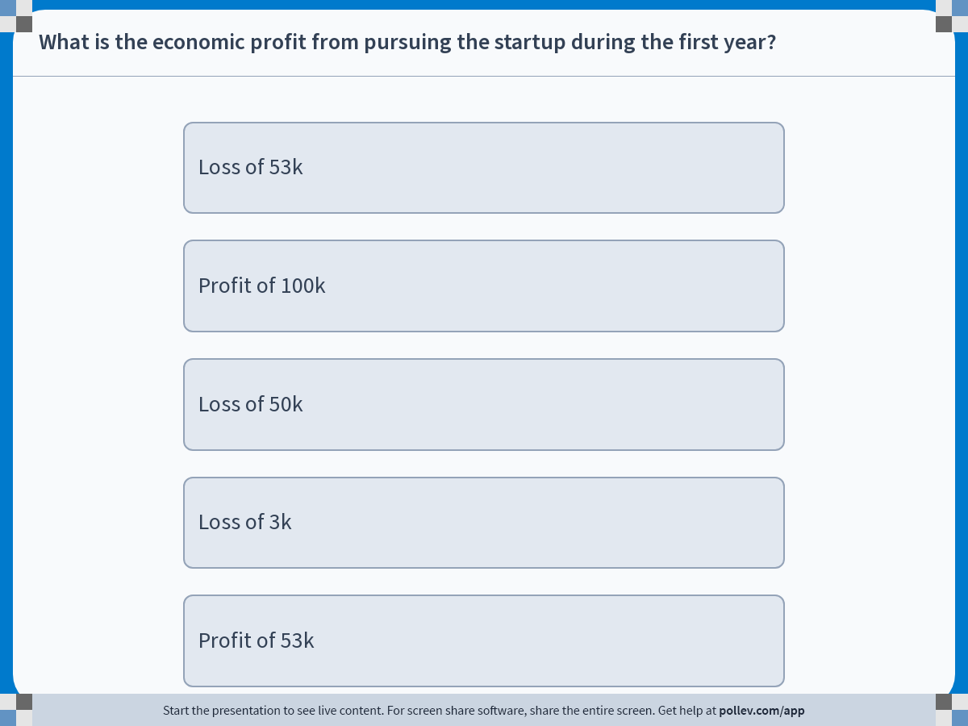
The Economic Way of Thinking · Opportunity Costs
Poll
Management 405 · The Economic Way of Thinking
24
Notes:
Do not modify the notes in this section to avoid tampering with the Poll Everywhere activity.
More info at polleverywhere.com/support
What is the economic profit from pursuing the startup during the first year?
https://www.polleverywhere.com/multiple_choice_polls/CojrOoYbqHMd1enpDsRiQ?display_state=instructions&activity_state=opened&state=opened&flow=Engagement&onscreen=persist

Slide 29
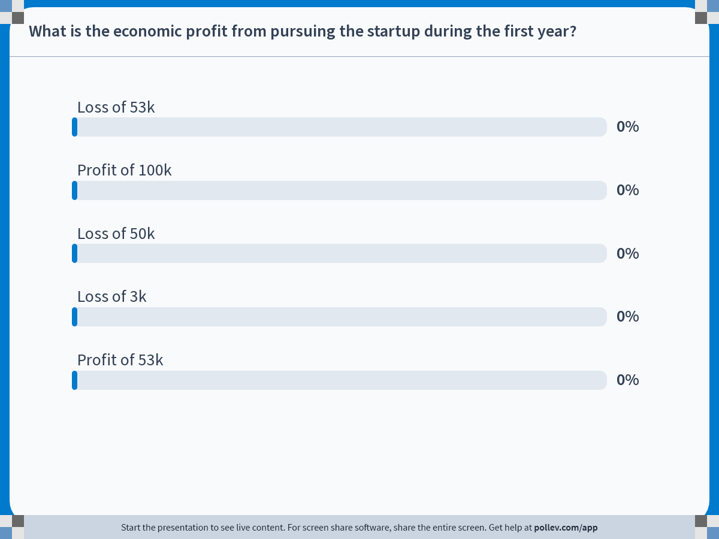
The Economic Way of Thinking · Opportunity Costs
Poll
Management 405 · The Economic Way of Thinking
25
Notes:
Do not modify the notes in this section to avoid tampering with the Poll Everywhere activity.
More info at polleverywhere.com/support
What is the economic profit from pursuing the startup during the first year?
https://www.polleverywhere.com/multiple_choice_polls/CojrOoYbqHMd1enpDsRiQ?display_state=chart&activity_state=opened&state=opened&flow=Engagement&onscreen=persist

Slide 30
The Economic Way of Thinking · Opportunity Costs
Solution
If Cindy starts her own company: $100,000
Revenue – explicit costs
$300,000-$200,000=$100,000
Best alternative: $153,000
Job in consulting: $150,000
Investment from $50,000 at 6%: $3,000
Economic loss of $53,000
Management 405 · The Economic Way of Thinking
26

Slide 31
The Economic Way of Thinking · Outline
Outline
1
Value of the Firm
What a firm maximizes — and why value is not the same as current profit
2
Basic Principles of Economic Thinking
Opportunity costs · Sunk costs · Cost-benefit and marginal analysis
3
Economics Fundamentals
Markets · Supply and Demand · Equilibrium
Management 405 · The Economic Way of Thinking
27

Slide 32
The Economic Way of Thinking · Sunk Costs
Ignore sunk costs
Sunk cost: a cost that, once paid, cannot be recovered
Ignore sunk costs: If the cost is sunk (already expended), it is not a factor relevant in determining the relative merits of the alternatives
Management 405 · The Economic Way of Thinking
28

Slide 33
The Economic Way of Thinking · Sunk Costs
Examples of sunk costs (you should ignore!)
Individual consumers
Fixed price dinners or buffets
Monthly gym memberships (once paid for the month)
Movie tickets; rented film on Amazon
Firms
Rent
Advertising
Other suggestions?
Management 405 · The Economic Way of Thinking
29
Notes:
Fixed price dinners
So full when dessert comes; should you eat it since you already paid for it?
Monthly gym memberships
Pay on the first of the month; should it factor into your decision to workout this month?
Movie tickets
30 minutes in and the movie is *terrible*; should you stay to get your money’s worth?

Slide 34
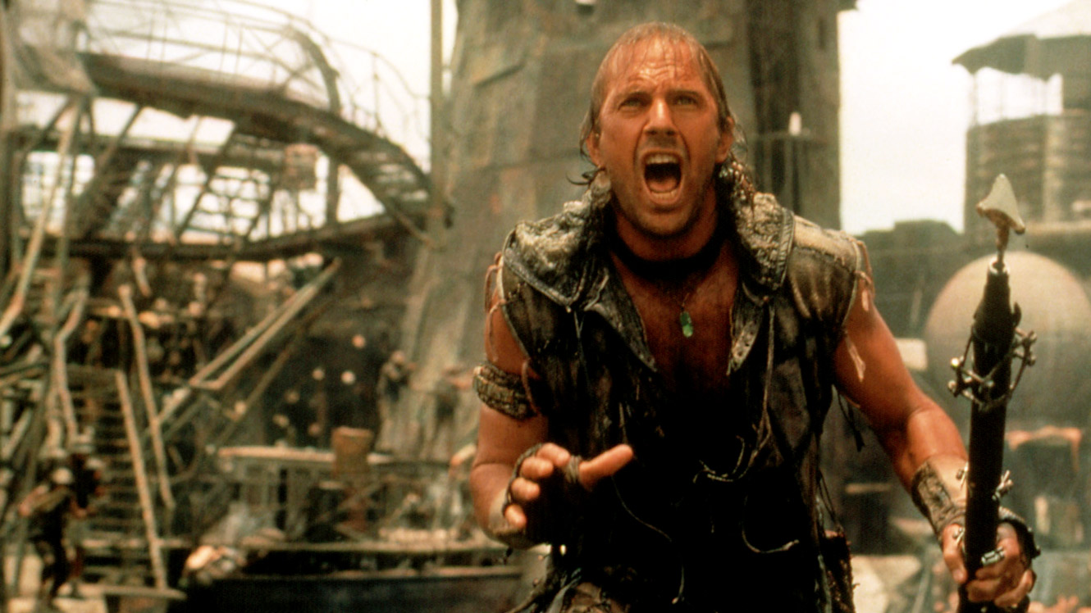
The Economic Way of Thinking · Sunk Costs
Why Do Film Studios Make Movies that They Know Will Lose Money?
Mini-case: Waterworld (1995)
Management 405 · The Economic Way of Thinking
30
Notes:
Waterworld came out in 1995, was filmed almost entirely under water in a Hawaiian harbor and cost $175 million in 1995 dollars to produce (before marketing and distribution expenses), at the time was the most expensive movie ever made.
Grossed $88 million in the US and about twice that abroad (about $300 million in ticket sales, assume studios get 50%). Studios only get a fraction of total ticket sales, so big flop.
Let’s use the principle of relevant costs to think through the decision making process of the studio at various stages of the production process.
At the beginning of production: expected movie to bring in $150 million of revenue, budget was $100 million with 96 days of filming.

Slide 35
The Economic Way of Thinking · Sunk Costs
Waterworld: Sunk Costs and Decisions over Time
June 1994
September 1994
December 1994
Expected Revenues ($M)
150
150
150
Sunk Cost ($M)
16
100
140
Expected Additional Cost ($M)
84 (<150)
40 (<150)
35 (<150)
Overall Cost (incl. sunk) ($M)
100
140
175
Expected Profit ($M)
+50
+10
−25
Decision
Make the film!
Make the film!
Make the film!
Ignore sunk costs — continue whenever Expected Revenue > Expected Additional Cost
Management 405 · The Economic Way of Thinking
35
Notes:
Here is the decision the studio faced, tracked at three points in time as more money got spent. Look at June 1994 first. Expected revenue from releasing is 150 million dollars. At that point only 16 million had been sunk into production, and it would cost another 84 million to finish and release. Since 84 million to finish is well below the 150 million it brings in, you release, and you expect a 50 million dollar profit. Now move to September. More has been sunk, 100 million, but the cost still to come has dropped to 40 million. Forty million to finish against 150 million in revenue, so you still release. By December, 140 million is sunk and only 35 million remains to release. Now look at the overall column, which adds the sunk cost back in. On paper the total is 175 million against 150 million of revenue, so it looks like a 25 million dollar loss, and the instinct is to shelve it. But that is the sunk-cost trap. The 140 million is already gone whether you release or not. The only number that matters now is the 35 million it takes to release against the 150 million it earns. So you release every single time. The rule at the bottom says it cleanly, ignore sunk costs, and go ahead whenever the extra revenue beats the extra cost.

Slide 36

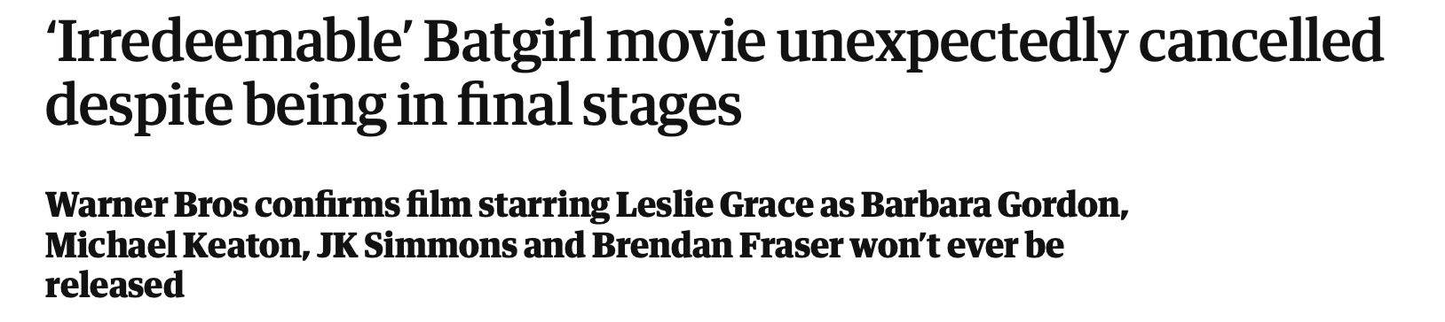
The Economic Way of Thinking · Sunk Costs
Why did Warner Bros. Cancel (an already finished) Batgirl?
Film budget: $100 million (sunk!)
But film performed poorly in test screenings
Cost of distribution/marketing > expected revenue from release
(Speculative) benefit from cancellation: tax write-off
For more: https://www.theguardian.com/film/2022/aug/03/irredeemable-batgirl-movie-unexpectedly-cancelled-despite-being-in-final-stages
Management 405 · The Economic Way of Thinking
32

Slide 37
The Economic Way of Thinking · Outline
Outline
1
Value of the Firm
What a firm maximizes — and why value is not the same as current profit
2
Basic Principles of Economic Thinking
Opportunity costs · Sunk costs · Cost-benefit and marginal analysis
3
Economics Fundamentals
Markets · Supply and Demand · Equilibrium
Management 405 · The Economic Way of Thinking
33

Slide 38
The Economic Way of Thinking · Cost-Benefit & Marginal Analysis
Objective: Maximize Net Benefits (= total benefits – total costs)
Cost-benefit and marginal analysis
To maximize net benefits from an activity, use marginal analysis
Marginal benefit (MB): additional benefit due to an extra unit of the activity (or an extra unit of a good/service)
Marginal cost (MC): additional cost due to an extra unit
Distinct from average benefit and average cost!
An extra unit is economically viable if MB > MC
Important Rule: Net benefits are maximized where MB = MC
Management 405 · The Economic Way of Thinking
34
Notes:
Suppose you want to open a coffee shop chain. First you open in the best (i.e. most profitable) location say in Santa Monica. You’ll get some profit (revenues less costs for baristas labor, beans, etc). Then you might want to expand to Venice, but the conditions might be worse (higher rent, more competition). You want to expand the coffee shop chain until the costs of marginal coffee shop equals its benefits, then stop.

Slide 39

The Economic Way of Thinking · Cost-Benefit & Marginal Analysis
How Many Hours per Week Should You Exercise?
Net Benefit
of Exercise
(in blue)
Maximizing the Net Benefit
Hour 1
Hour 2
Hour 3
Hour 4
Hour 5
Management 405 · The Economic Way of Thinking
35

Slide 40
The Economic Way of Thinking · Outline
Outline
1
Value of the Firm
What a firm maximizes — and why value is not the same as current profit
2
Basic Principles of Economic Thinking
Opportunity costs · Sunk costs · Cost-benefit and marginal analysis
3
Economics Fundamentals
Markets · Supply and Demand · Equilibrium
Management 405 · The Economic Way of Thinking
36

Slide 41
The Economic Way of Thinking · Outline
Outline
1
Value of the Firm
What a firm maximizes — and why value is not the same as current profit
2
Basic Principles of Economic Thinking
Opportunity costs · Sunk costs · Cost-benefit and marginal analysis
3
Economics Fundamentals
Markets · Supply and Demand · Equilibrium
Management 405 · The Economic Way of Thinking
37

Slide 42
The Economic Way of Thinking · Markets
Market Definition
A company must understand its market
Its customers
But also its actual and potential competitors
Extent of market
Which products
Is corn syrup a distinct market?
Relevant for antitrust litigation (e.g. ADM acquisition of CCP)
Geographic boundaries
Coffee shop in Venice
Gasoline
Gold
Management 405 · Market Equilibrium
38

Slide 43


The Economic Way of Thinking · Markets
Market Definition: The Case of Netflix
Define Netflix’s market
Online streaming?
All TV/films?
All entertainment?
Class discussion
Management 405 · Market Equilibrium
39

Slide 44
The Economic Way of Thinking · Outline
Outline
1
Value of the Firm
What a firm maximizes — and why value is not the same as current profit
2
Basic Principles of Economic Thinking
Opportunity costs · Sunk costs · Cost-benefit and marginal analysis
3
Economics Fundamentals
Markets · Supply and Demand · Equilibrium
Management 405 · The Economic Way of Thinking
40

Slide 45
The Economic Way of Thinking · Supply and Demand
The Market Demand Curve
Definition: the relationship between the quantity of a good that consumers are willing to buy and the price of the good, holding everything else constant
Management 405 · Market Equilibrium
41
Notes:
Note: aside from price, we are holding everything else constant, including consumers’ income, tastes, price of other goods.
Thought experiment: suppose you show up at Pike Place Market on a Saturday and observe the price of tomatoes and total quantity that consumers buy. Suppose you can go back in time to that same Saturday and replace all the price tags using an alternative price and see the quantity that consumers buy. Do this over and over until you trace out the demand curve. If tomatoes are $2/pound in one iteration, some people will buy. If they are $1/pound, additional people will buy. As price declines, more consumers want to purchase it. This will make the demand curve downward sloping.
We will get into this in much more detail next week.

Slide 46

The Economic Way of Thinking · Supply and Demand
“Holding everything else constant”
Want to know: how the quantity demanded of an ice cream cone changes with a price increase
Assume: Everything else that affects the quantity demanded remains constant
What is held constant?
Consumer income
Outside temperature
Prices of related goods
Taste for ice cream flavors
Size, shape, quality of the ice cream cone
Anything other than price
Things are not held constant between these two cones
Management 405 · Market Equilibrium
42
Notes:
Note: aside from price, we are holding everything else constant, including consumers’ income, tastes, price of other goods.
Thought experiment: suppose you show up at Pike Place Market on a Saturday and observe the price of tomatoes and total quantity that consumers buy. Suppose you can go back in time to that same Saturday and replace all the price tags using an alternative price and see the quantity that consumers buy. Do this over and over until you trace out the demand curve. If tomatoes are $2/pound in one iteration, some people will buy. If they are $1/pound, additional people will buy. As price declines, more consumers want to purchase it. This will make the demand curve downward sloping.
We will get into this in much more detail next week.

Slide 47
The Economic Way of Thinking · Supply and Demand
The Market Demand Curve
Definition: The relationship between the quantity of a good that consumers are willing to buy and the price of the good, holding everything else constant
Price ($)
Characteristics:
Downward sloping: consumers want to purchase more of a good as its price goes down, all else constant
D
Quantity
Management 405 · Market Equilibrium
43
Notes:
Note: aside from price, we are holding everything else constant, including consumers’ income, tastes, price of other goods.
Thought experiment: suppose you show up at Pike Place Market on a Saturday and observe the price of tomatoes and total quantity that consumers buy. Suppose you can go back in time to that same Saturday and replace all the price tags using an alternative price and see the quantity that consumers buy. Do this over and over until you trace out the demand curve. If tomatoes are $2/pound in one iteration, some people will buy. If they are $1/pound, additional people will buy. As price declines, more consumers want to purchase it. This will make the demand curve downward sloping.
We will get into this in much more detail next week.

Slide 48
The Economic Way of Thinking · Supply and Demand
The Market Demand Curve
Distinguish between:
Movement along D: changes in quantity demanded when price changes, all else constant
Shifts of D: changes in demand due to non-price factors
e.g. a higher income level shifts the demand curve to the right (from D₀ to D₁)
Price ($)
P₁
P₀
D₀
D₁
Q₀
Q₁
Quantity
Management 405 · Market Equilibrium
44

Slide 49


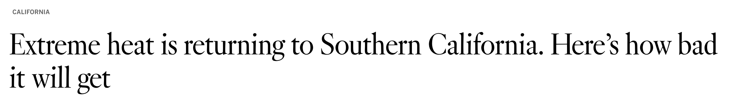
The Economic Way of Thinking · Supply and Demand
Heat Waves and the Demand for Air Conditioning
How do heatwaves affect the demand for ACs?
PollEV
Management 405 · Market Equilibrium
45

Slide 50
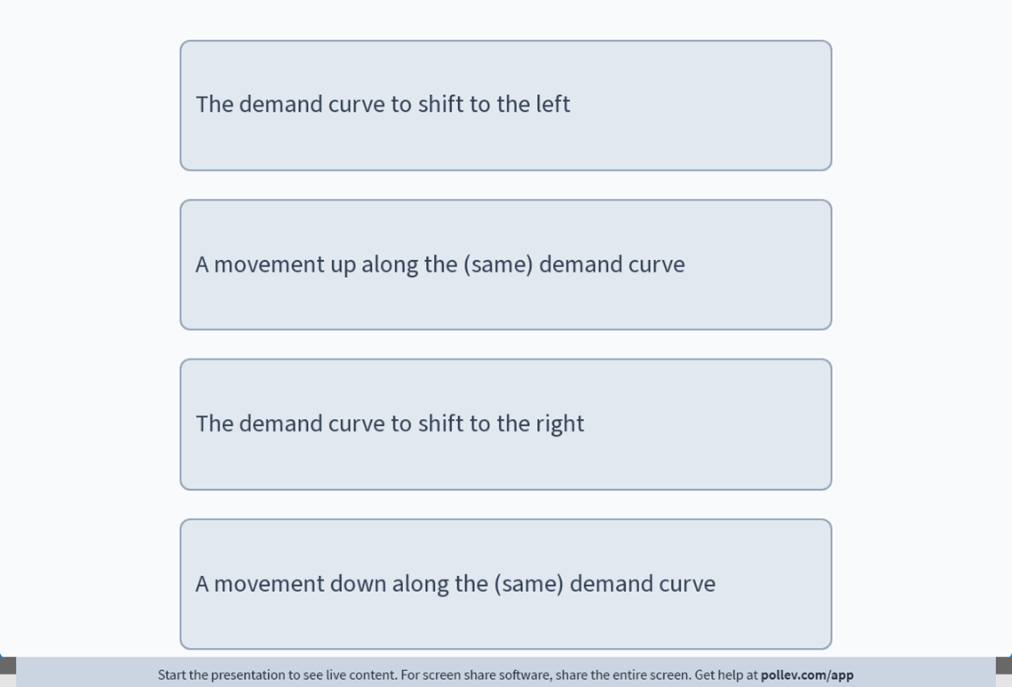
The Economic Way of Thinking · Supply and Demand
How do Heat Waves affect the Demand for AC?
They cause…
Management 405 · Market Equilibrium
46

Slide 51
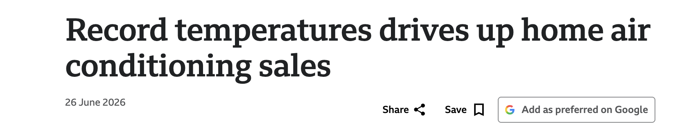
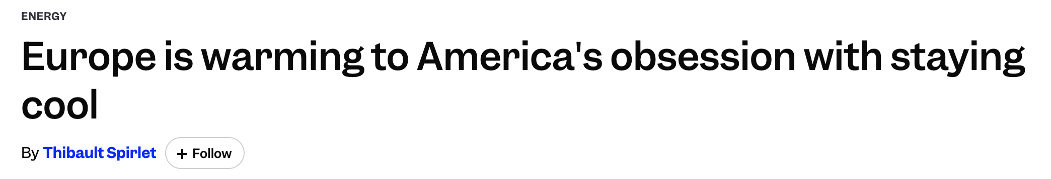
The Economic Way of Thinking · Supply and Demand
Shifts of the Demand Curve for AC
The heatwaves should cause the demand curve to shift outward (to the right)
Management 405 · Market Equilibrium
47

Slide 52



The Economic Way of Thinking · Supply and Demand
Swiftonomics
How did Taylor Swift’s engagement affect the demand for diamonds?
PollEV
Management 405 · Market Equilibrium
45

Slide 53
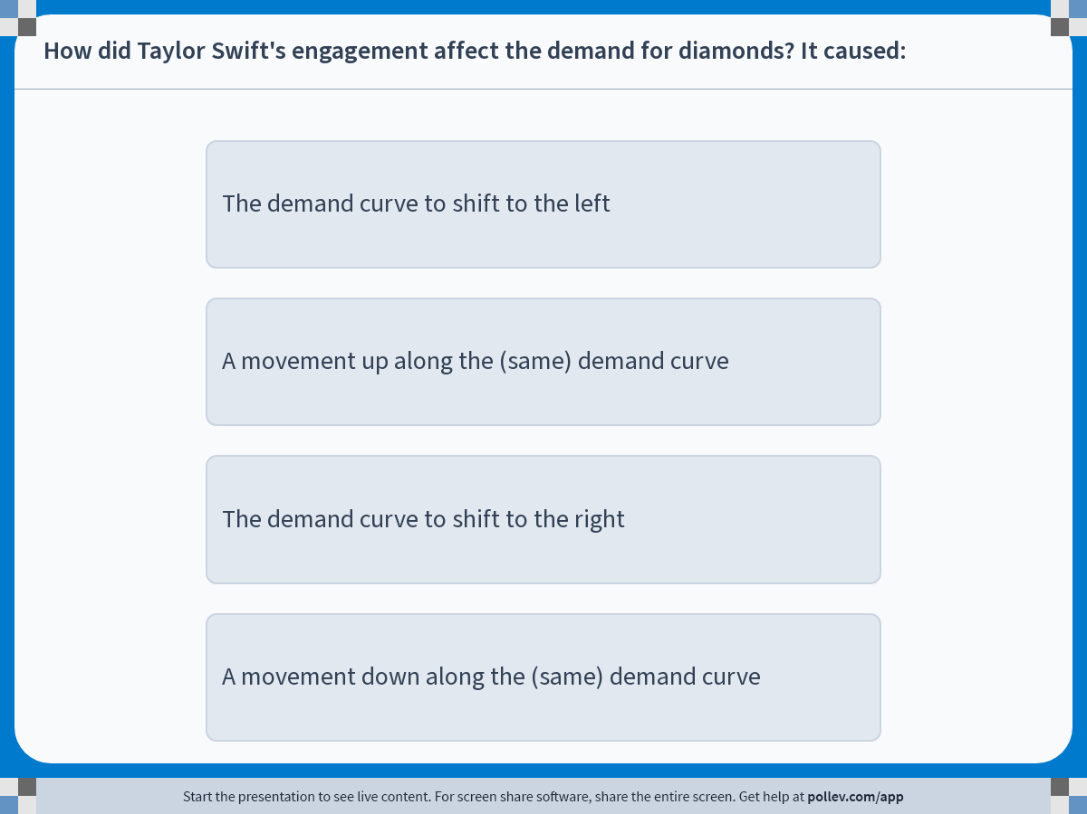
The Economic Way of Thinking · PollEV
Poll
Management 405 · Market Equilibrium
46
Notes:
Do not modify the notes in this section to avoid tampering with the Poll Everywhere activity.
More info at polleverywhere.com/support
How did Taylor Swift's engagement affect the demand for diamonds? It caused:
https://www.polleverywhere.com/multiple_choice_polls/WjwqVzdkXzlKkhNbC92oD?display_state=instructions&activity_state=opened&state=opened&flow=Engagement&onscreen=persist

Slide 54
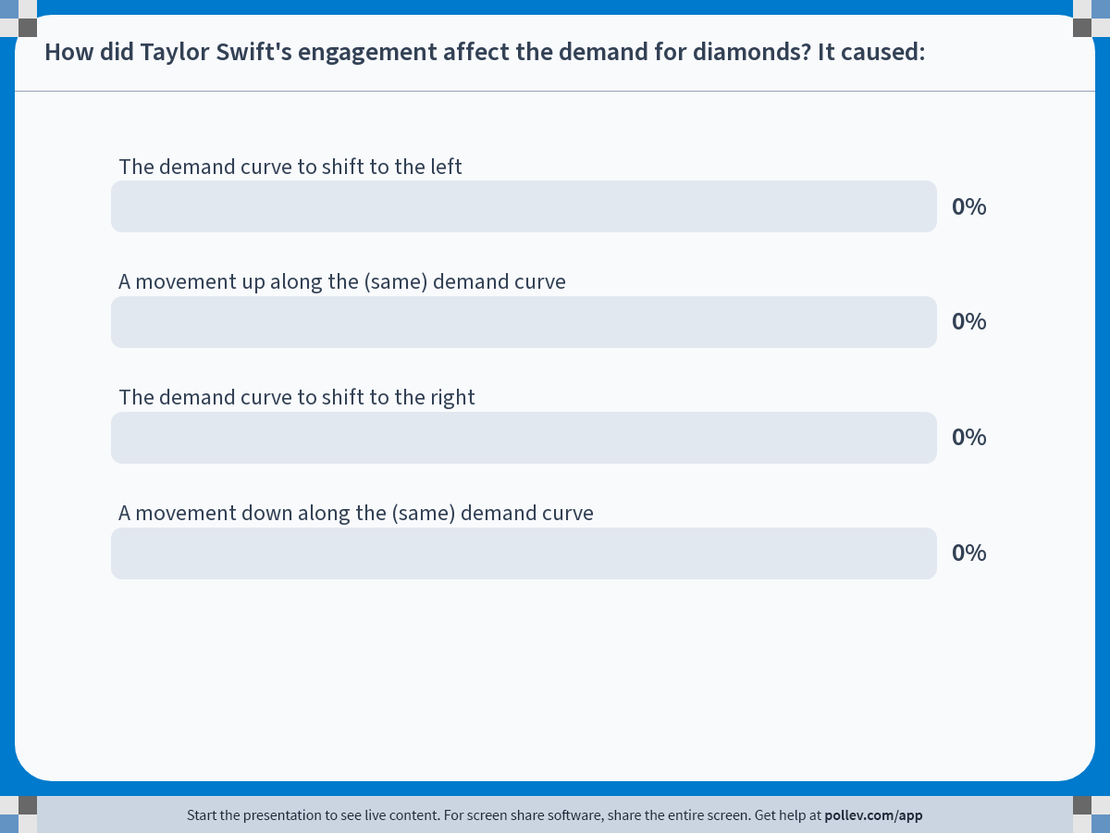
The Economic Way of Thinking · PollEV
Poll
Management 405 · Market Equilibrium
47
Notes:
Do not modify the notes in this section to avoid tampering with the Poll Everywhere activity.
More info at polleverywhere.com/support
How did Taylor Swift's engagement affect the demand for diamonds? It caused:
https://www.polleverywhere.com/multiple_choice_polls/WjwqVzdkXzlKkhNbC92oD?display_state=chart&activity_state=opened&state=opened&flow=Engagement&onscreen=persist

Slide 55

The Economic Way of Thinking · Supply and Demand
Solution
Taylor Swift’s engagement caused the demand curve to shift to the right
“Google searches for “diamond ring” surged after the announcement.”
“Diamond-jewelry retailers […] saw their stock prices rise […] on Tuesday, the day Swift announced her engagement with football star Travis Kelce, posting a picture of her diamond ring.”
Management 405 · Market Equilibrium
48

Slide 56
The Economic Way of Thinking · Supply and Demand
The Market Supply Curve
Definition: Describes the relationship between the quantity of a good that producers are willing to sell and the price of the good, holding everything else constant
Price ($)
Characteristics:
Upward sloping: the higher the price, the more firms are able and willing to produce and sell, all else constant
S
Quantity
Management 405 · Market Equilibrium
49
Notes:
As price rises, quantity supplied will increase. Intuition for upward sloping: many firms experience increasing costs of production as their output rises; need to earn higher price in order to be willing to sell more output. We will get into this in much more detail in Module 4.

Slide 57
The Economic Way of Thinking · Supply and Demand
The Market Supply Curve
Distinguish between:
Movement along S: changes in quantity supplied when price changes, all else constant
Shifts of S: changes in supply; e.g. a shift to the right (from S₀ to S₁) means firms can produce a larger quantity at the same price or the same quantity at a lower price
Price ($)
S₀
S₁
P₀
P₁
Q₀
Q₁
Quantity
Management 405 · Market Equilibrium
50

Slide 58
The Economic Way of Thinking · Outline
Outline
1
Value of the Firm
What a firm maximizes — and why value is not the same as current profit
2
Basic Principles of Economic Thinking
Opportunity costs · Sunk costs · Cost-benefit and marginal analysis
3
Economics Fundamentals
Markets · Supply and Demand · Equilibrium
Management 405 · The Economic Way of Thinking
51

Slide 59
The Economic Way of Thinking · Equilibrium
The Market Mechanism
Price ($)
Market equilibrium: where supply and demand intersect, at price P₀ and quantity Q₀
At a higher price P₁, a surplus develops, so the price falls
At a lower price P₂, there is excess demand, so the price is bid up
S
Surplus
P₁
P₀
P₂
Excess demand
D
Q₀
Quantity
Management 405 · Market Equilibrium
52
Notes:
The point where they intersect is called market equilibrium, the price at which the quantity supplied equals the quantity demanded.
To see why market equilibrium is stable, let’s go through what happens when the price deviates from the equilibrium condition:
Suppose the price is higher than P_0; What happens at this price? Producers will start entering the market, wanting to sell at this high price, but they won’t all be able to find willing buyers. Then the quantity supplied will be greater than the quantity demanded. The excess quantity supplied is known as surplus. To eliminate the surplus, producers need to attract more buyers and to do so, they have to lower their prices. As price falls, quantity demanded increases, and the quantity supplied falls until the market reaches equilibrium.
Suppose the price is lower than P_0; then the quantity demanded will exceed the quantity supplied and shortage will develop; To eliminate this shortage, buyers who cannot find the good available for sale will bid up the price and enterprising producers will be more than willing to raise their prices. As price rises, quantity demanded falls, quantity supplied rises, until we reach equilibrium.
How does the market reach equilibrium in practice? Adam Smith’s invisible hand.

Slide 60
The Economic Way of Thinking · Equilibrium
Summary of Terminology
Equilibrium (or market clearing) price:
Price that equates the quantity supplied to the quantity demanded
Market mechanism:
Tendency in a free market for price to change until the market clears
Excess Supply:
Situation in which the quantity supplied exceeds the quantity demanded
Excess Demand (shortage):
Situation in which the quantity demanded exceeds the quantity supplied
Management 405 · Market Equilibrium
53

Slide 61
The Economic Way of Thinking · Equilibrium
Changes in Market Equilibrium: Shift in Demand
When the demand curve shifts to the right, the market clears at a higher price P₃ and a larger quantity Q₃
Price ($)
S
P₃
Tomatoes cure cancer
P₀
D₀
D₁
Q₀
Q₃
Quantity
Management 405 · Market Equilibrium
54
Notes:
Shift out of demand implies that at any given price, consumers will want to buy more.
If the price stayed the same, then a shortage would develop; price needs to rise in order to equilibrate the market.
As price rises, quantity demanded falls and quantity supplied increases until we arrive at the new higher equilibrium price and quantity.

Slide 62
The Economic Way of Thinking · Equilibrium
Changes in Market Equilibrium: Shift in Supply
When the supply curve shifts to the right, the market clears at a lower price P₄ and a larger quantity Q₄
Price ($)
S₀
S₁
Faster harvester
P₀
P₄
D₀
Q₀
Q₄
Quantity
Management 405 · Market Equilibrium
55
Notes:
Shift out of supply implies that at any given price, producers are willing to sell a larger quantity.
If the price stayed in its original position then there would be excess supply; price needs to fall to equilibrate the market.
As the price falls, quantity demanded rises and quantity supplied declines.
Price falls until the quantity supplied and quantity demanded are equal.

Slide 63
The Economic Way of Thinking · Equilibrium
Changes in Market Equilibrium: Shift in Supply and Demand
Price ($)
In this case, shifts in both curves lead to a slightly higher price P₅ and a much larger quantity Q₅
Note: An even larger shift in S will lead to a lower price. But quantity unambiguously increases
S₀
S₁
P₅
P₀
D₁
D₀
Q₀
Q₅
Quantity
Management 405 · Market Equilibrium
56
Notes:
Two shifts simultaneously!
When both curves shift, the prediction for either price or quantity will be ambiguous. It will depend on the magnitude of the shift in supply and demand. In the example on this slide, we observe that the prediction for price is ambiguous. It can either increase or decrease depending on how large the shifts in supply and demand are (above a small increase is depicted; as an exercise at home, see if you can shift the curves outward and generate a decrease in the equilibrium price). The prediction for quantity, however, is clear. It increases due to the shift out of both supply and demand.

Slide 64
The Economic Way of Thinking · Equilibrium
Effect of Shifts in Demand and Supply Curves in Isolation
Curve that shifts
Direction of shift
Impact on Equilibrium
Price
Quantity
Demand Curve
Out (increase in D)
↑
↑
In (decrease in D)
↓
↓
Supply Curve
Out (increase in S)
↓
↑
In (decrease in S)
↑
↓
Important: As a general rule, when both curves shift at the same time, we will know with certainty the direction of change of either the equilibrium price or quantity, but never both.
Management 405 · Market Equilibrium
57

Slide 65
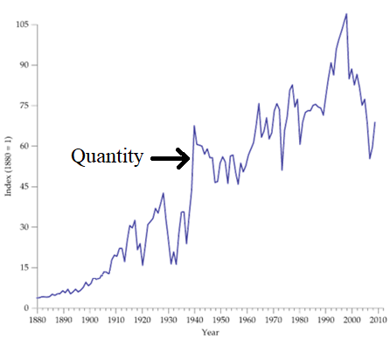
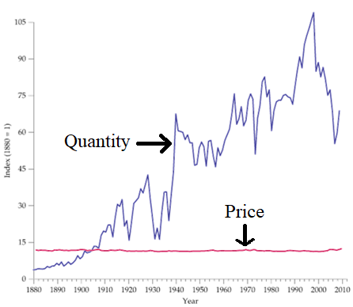
The Economic Way of Thinking · Equilibrium
Mini-Case: The International Copper Market since 1880
Annual consumption (in tons) increased hundredfold
SLIDE TITLE
Price (inflation-adjusted) remained constant
Use supply + demand framework to explain
Management 405 · Market Equilibrium
58

Slide 66
The Economic Way of Thinking · Equilibrium
The Market for Copper
Price ($)
S₀
S₁
P₁ = P₀
D₀
D₁
Q₀
Q₁
Quantity
Management 405 · Market Equilibrium
59
Notes:
While it may looks puzzling at first, supply and demand shifts can explain it. Demand shifted right over time due to industrialization, population growth, and new uses (construction, electronics). Supply also shifted right because of advances in mining and transportation. These simultaneous shifts explain rising quantities but stable prices.

Slide 67

The Economic Way of Thinking · Equilibrium
Mini-Case: Los Angeles Residential Real Estate
From Sep-2021 to Sep-2025, in Los Angeles (Redfin data):
Inflation-adjusted home prices: ▼5%
Home sales: ▼40%
Explain using supply and demand framework!
Group discussion
Management 405 · Market Equilibrium
60
Notes:
Source: https://www.redfin.com/city/11203/CA/Los-Angeles/housing-market

Slide 68
The Economic Way of Thinking · Equilibrium
Market for Los Angeles Residential Real Estate
Price ($)
S₀
S₁
P₀
P₁
D₁
D₀
Q₁
Q₀
Quantity
Demand curve: shift inward due to higher mortgage rates and out-migration
Supply curve: owners ”locked in” to lower mortgage rates and postponed selling
Management 405 · Market Equilibrium
61
Notes:
Since both prices (in real terms) and sales dropped, this suggests both demand and supply curves shifted left. For example, perhaps demand fell due to higher mortgage rates and migration. Maybe supply fell as owners were “locked in” low mortgages and delayed selling.

Slide 69
The Economic Way of Thinking · Equilibrium
Steps to understand “shocks” to Supply and Demand
Figure out what the shock is
2. Determine whether the shock shifts the demand or supply curve
3. Draw the market’s demand and supply curves before and after the shock
Management 405 · Market Equilibrium
62

Slide 70
The Economic Way of Thinking · Summary
Module 1 Summary
Value of the firm
Key economic principles for decision-making
Economic costs include opportunity costs
Ignore sunk costs
Use cost-benefit and marginal analysis
Markets, supply, and demand
Market equilibrium: intersection of supply and demand
Management 405 · Market Equilibrium
63

Slide 71
The Economic Way of Thinking · Next Steps
Next Steps
Problem set 1 posted
Due October 3 by midnight
TA will send submission instructions via email/BruinLearn
Optional practice exercises in the textbook and Achieve
Module 2: Demand Analysis
Textbook reading
Read news article I will send via email/BruinLearn
Take survey I will send via email/BruinLearn
Management 405 · Market Equilibrium
64

